Slide 1


Managing
Database Ojects
with Navicat
Navicat Certified Database Administrator - Associate

Slide 2

HKIIT - Navicat Certified Database Administrator - Associate
Lessons Intended Learning Outcome
On completion of this lesson(s), students are expected to be able to:
(#1) Design views using Navicat’s view builder for customized data display.
(#2) Create and Call User-Defined Functions
(#3) Use scheduled event to automate repetitive tasks

Slide 3
HKIIT - Navicat Certified Database Administrator - Associate
Learning Outline
Introduction to Views, Events, and User-Defined Functions in MySQL
Benefits of using view
Triggers vs Events
Scheduled Events in MySQL

Slide 4

HKIIT - Navicat Certified Database Administrator - Associate
COMMON TYPES
Database Objects
01
04
Tables
Functions
02
05
Triggers
Events
03
06
Views
Queries

Slide 5
HKIIT - Navicat Certified Database Administrator - Associate
DATABASE OBJECT
Views
A MySQL view is a Virtual Table created by a query that combines the results of a SELECT statement. The View is re-created on demand each time it is invoked.
Views do not store data themselves but provide a way to simplify complex queries by abstracting the underlying database schema details.
Enhances Security: limits the data that a user is allowed to retrieve.
Ensures Data Consistency: Centralizes common queries to maintain consistency.

Slide 6

DATABASE
Create a view In MySQL
The CREATE VIEW statement has the following syntax:
CREATE VIEW view_name AS
SELECT column1, column2, ...
FROM table_name
[WHERE condition]
[WITH CHECK OPTION]
MySQL :: MySQL 8.4 Reference Manual :: 15.1.23 CREATE VIEW Statement
HKIIT - Navicat Certified Database Administrator - Associate

Slide 7
DATABASE
Dropping view
The CREATE VIEW statement has the following syntax:
Drop view <view name>;
MySQL :: MySQL 8.4 Reference Manual :: 15.1.23 CREATE VIEW Statement
HKIIT - Navicat Certified Database Administrator - Associate

Slide 8
DATABASE
Example
Create a MySQL view for employees working at FairyLand theme park
SELECT employee.EMP_FNAME, employee.EMP_LNAME, employee.EMP_PHONE
FROM employee
INNER JOIN themepark ON employee.PARK_CODE = themepark.PARK_CODE
WHERE themepark.PARK_NAME = 'FairyLand’
HKIIT - Navicat Certified Database Administrator - Associate

Slide 9
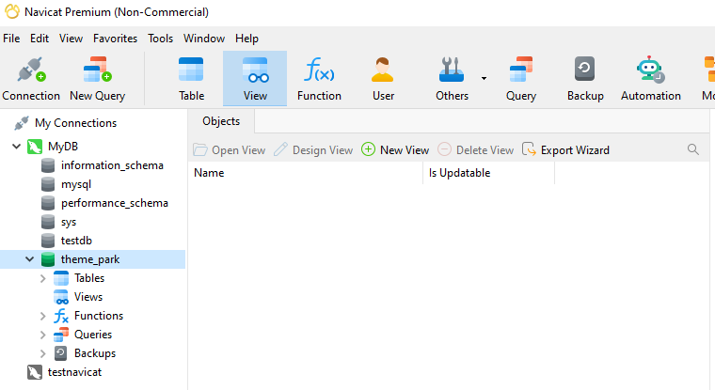
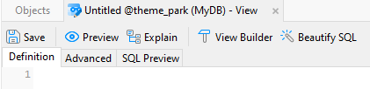
DATABASE
Create a MySQL with Navicat
A visual editing tool - View Builder
A visual editing tool -
View Builder
HKIIT - Navicat Certified Database Administrator - Associate

Slide 10
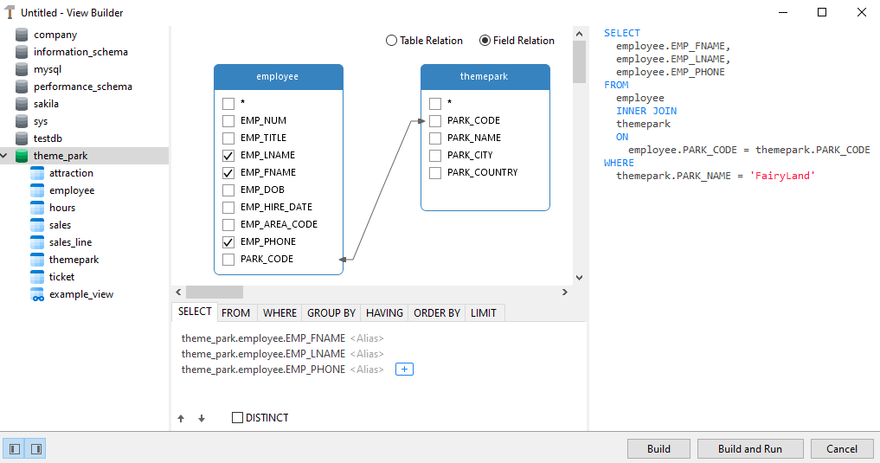
DATABASE
View Builder
Diagram
SQL pane
Object pane
Criteria pane
HKIIT - Navicat Certified Database Administrator - Associate

Slide 11
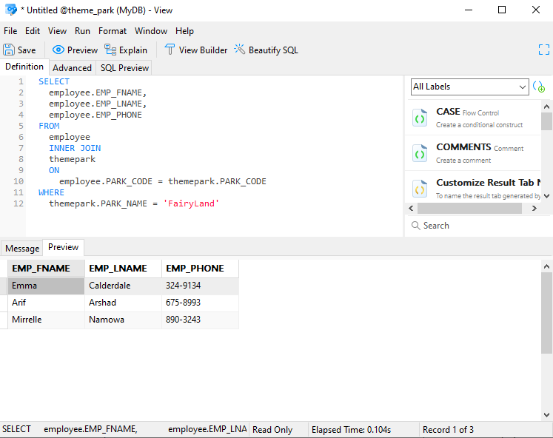
DATABASE
Create a MySQL with Navicat
Enter the query statement
Click preview button to see the results
HKIIT - Navicat Certified Database Administrator - Associate

Slide 12
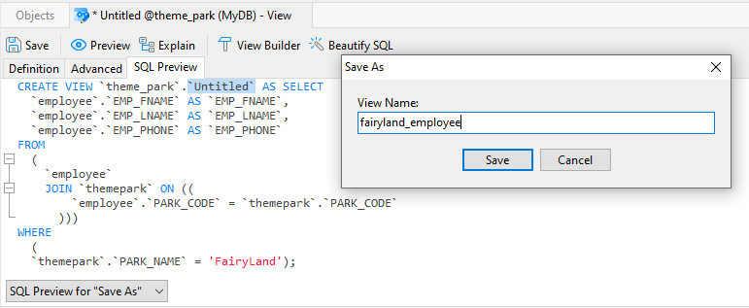
DATABASE
Create a MySQL with Navicat
The SQL Preview shows the generated CREATE VIEW statement
The new view is named `Untitled` until we save it.
HKIIT - Navicat Certified Database Administrator - Associate

Slide 13
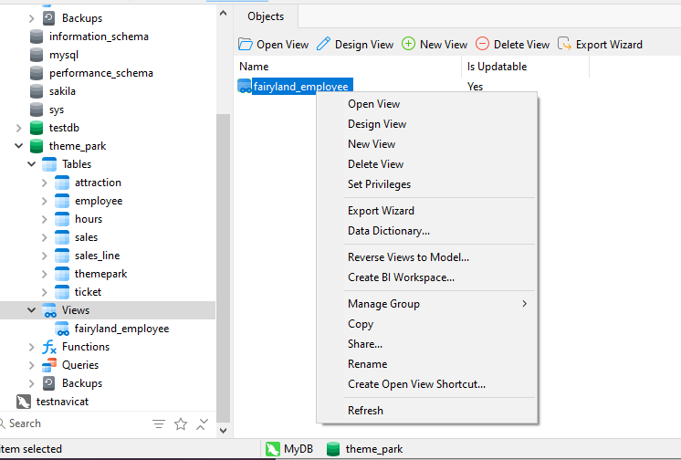
DATABASE
Manage Views in Navicat
All views can be found in the navigation pane on the left-hand side.
To modify the definition of view,
click `Design view`
HKIIT - Navicat Certified Database Administrator - Associate

Slide 14
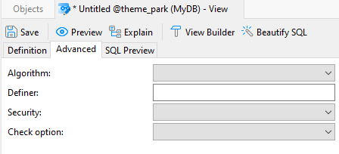
DATABASE
Advanced Setting for the view
The Advanced tab contains additional options:
The default object definer is the user who creates it.
The default object definer is the user who creates it.
MySQL :: MySQL 8.4 Reference Manual :: 27.6 Stored Object Access Control
HKIIT - Navicat Certified Database Administrator - Associate

Slide 15
HKIIT - Navicat Certified Database Administrator - Associate
DATABASE OBJECT
User-Defined Functions
A User-Defined Function is a set of SQL statements that perform some operation (calculations, string manipulations) and return a single value based on conditions.
The Create Function command has the following syntax:
CREATE FUNCTION function_name (parameter datatype)
RETURNS return_datatype
[DETERMINISTIC | NOT DETERMINISTIC]
BEGIN
declaration_section
executable_section
END;

Slide 16
FUNCTION
Deterministic and Non-Deterministic
A deterministic function always gives the same answer when it has the same inputs.
A non-deterministic function produces variable outputs. Example: RAND(),UUID()
Misdeclaring a deterministic function as non-deterministic might hurt query performance.
Misdeclaring a non-deterministic function as deterministic might lead to incorrect query results.
By default, MySQL uses the NOT DETERMINISTIC option.
MySQL :: MySQL 8.4 Reference Manual :: 10.2.1.20 Function Call Optimization
HKIIT - Navicat Certified Database Administrator - Associate

Slide 17
FUNCTION
Deterministic
In MySQL 8.4, Binary logging is enabled by default.
For a CREATE FUNCTION statement to be accepted, at least one of DETERMINISTIC, NO SQL, or READS SQL DATA must be specified explicitly.
This function is deterministic (and does not modify data):
CREATE FUNCTION f1(i INT)
RETURNS INT
DETERMINISTIC
READS SQL DATA
BEGIN
RETURN i;
END;
MySQL :: MySQL 8.4 Reference Manual :: 10.2.1.20 Function Call Optimization
HKIIT - Navicat Certified Database Administrator - Associate

Slide 18
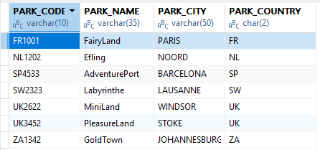
FUNCTION
Example:
Convert the country code to its full name
CREATE FUNCTION GetCountryName(PARK_COUNTRY CHAR(2))
RETURNS VARCHAR(50)
DETERMINISTIC
BEGIN
DECLARE result VARCHAR(50);
IF PARK_COUNTRY = 'UK' THEN
SET result = 'United Kingdom';
ELSEIF PARK_COUNTRY = 'FR' THEN
SET result = 'France';
ELSEIF PARK_COUNTRY = 'NL' THEN
SET result = 'The Netherlands';
ELSEIF PARK_COUNTRY = 'SP' THEN
SET result = 'Spain';
ELSEIF PARK_COUNTRY = 'ZA' THEN
SET result = 'South Africa';
ELSEIF PARK_COUNTRY = 'SW' THEN
SET result = 'Switzerland';
ELSE
SET result = 'Unknown';
END IF;
RETURN result;
END
HKIIT - Navicat Certified Database Administrator - Associate

Slide 19
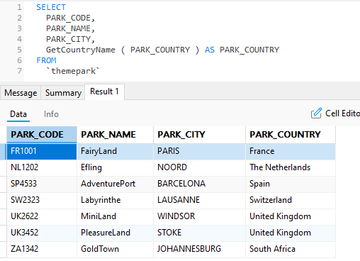
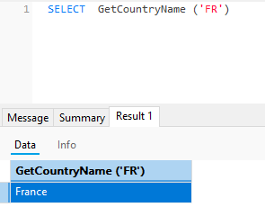
FUNCTION
Call function with parameter
HKIIT - Navicat Certified Database Administrator - Associate

Slide 20
HKIIT - Navicat Certified Database Administrator - Associate
DATABASE OBJECT
Events
MySQL Events are tasks that execute according to a defined schedule.
Example: Data archive and log cleansing purposes.
Trigger vs Event
A trigger is a database object whose statements are executed in response to a specific type of event that occurs on a given table.
A (scheduled) event is an object whose statements are executed in response to the passage of a specified time interval.
An event's timing can be either one-time or recurrent.

Slide 21
EVENT
Why Use MySQL Events?
Automate repetitive tasks (e.g., daily summary reports).
Perform maintenance tasks (e.g., purging old records).
Schedule data updates or calculations at specific intervals.
HKIIT - Navicat Certified Database Administrator - Associate

Slide 22
EVENT
Example: Maintaining Logs
Create a table for maintaining logs of scheduled and unscheduled maintenance activities for theme park attractions, along with a MySQL event that regularly inserts records into this table.
CREATE TABLE MAINTENANCE_LOG (
LOG_ID INT AUTO_INCREMENT PRIMARY KEY,
ATTRACT_NO NUMERIC(10) NOT NULL,
MAINTENANCE_DATE DATE NOT NULL,
MAINTENANCE_DETAILS VARCHAR(255) NOT NULL,
CONSTRAINT FK_MAINTENANCE_ATTRACT FOREIGN KEY (ATTRACT_NO) REFERENCES ATTRACTION(ATTRACT_NO)
);
HKIIT - Navicat Certified Database Administrator - Associate

Slide 23
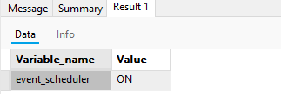
EVENT
Setting Up the Environment
Before creating and scheduling events, ensure that the MySQL Event Scheduler is enabled.
Check if the Event Scheduler is enabled:
Execute command: SHOW VARIABLES LIKE 'event_scheduler’;
2. Enable the Event Scheduler if it is disabled:
Execute command: SET GLOBAL event_scheduler = ON;
HKIIT - Navicat Certified Database Administrator - Associate

Slide 24
DATABASE
Create a MySQL Event
The CREATE EVENT statement has the following syntax:
CREATE EVENT event_name
ON SCHEDULE schedule
ON COMPLETION [PRESERVE | NOT PRESERVE]
[ENABLE | DISABLE | DISABLE ON {REPLICA | SLAVE}]
DO
event_body
MySQL :: MySQL 8.4 Reference Manual :: 15.1.13 CREATE EVENT Statement
HKIIT - Navicat Certified Database Administrator - Associate

Slide 25
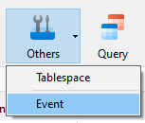
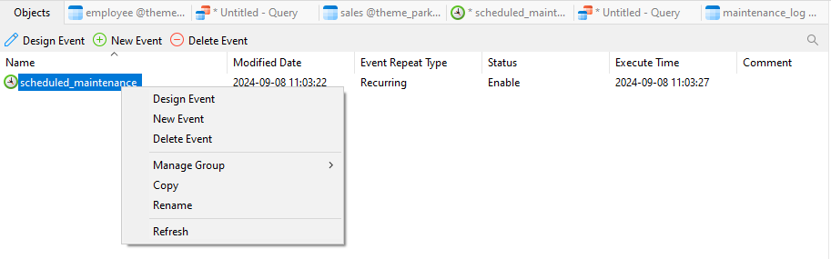
EVENT
Navicat's event designer
1. Click on the Event button in the toolbar
2. List out all events in the database
HKIIT - Navicat Certified Database Administrator - Associate

Slide 26
EVENT
Navicat's event designer
3. Click on the New Event button
This will bring in Navicat's event designer.
HKIIT - Navicat Certified Database Administrator - Associate

Slide 27
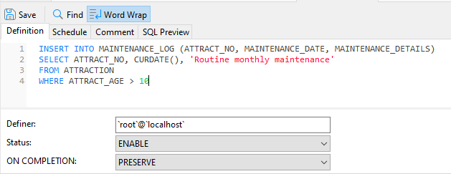
EVENT
Navicat's event designer
Definition tab
HKIIT - Navicat Certified Database Administrator - Associate

Slide 28
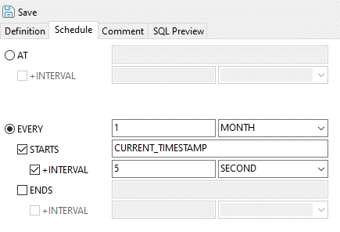
EVENT
Navicat's event designer
Adjusting the timing of the event in the ‘Schedule’ tab of the event designer.
HKIIT - Navicat Certified Database Administrator - Associate

Slide 29
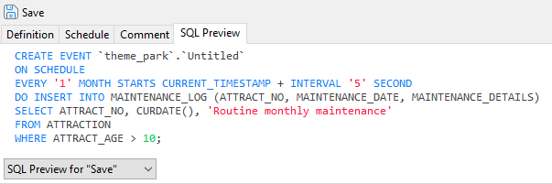
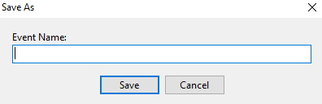
EVENT
Navicat's event designer
In SQL Preview tab, the complete CREATE EVENT statement.
Click save and enter the event name:
HKIIT - Navicat Certified Database Administrator - Associate

Slide 30
EVENT
Navicat's event designer
1. Click on the Event button in the toolbar
HKIIT - Navicat Certified Database Administrator - Associate

Slide 31
DATABASE
Simulate Event Execution
To manually trigger the event for testing purposes, you can use the following command:
CALL event_name();
MySQL :: MySQL 8.4 Reference Manual :: 15.1.13 CREATE EVENT Statement
HKIIT - Navicat Certified Database Administrator - Associate

Slide 32

Navicat
Managing Views, Events and UDF
In this lesson, we explored essential database features in Navicat, focusing on designing customized views, creating user-defined functions, and setting up scheduled events. We learned to leverage Navicat's intuitive interface to simplify data retrieval and automate repetitive tasks, equipping ourselves with valuable tools for effective database management.
HKIIT - Navicat Certified Database Administrator - Associate

